Slide 1
COMS10003: Dealing with Uncertainty
Random Variables II
Andrew Calway

Slide 2
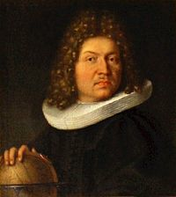
Bernoulli Distribution
Two value random variable, e.g.
probability of being 1
probability of being 0
Jacob
Bernoulli
p
(1-p)
0
1

Slide 3
Binomial Distribution
RV - number of times one value occurs in n independent two value experiments, e.g. coin flipping H or T
Probability of getting k heads in n flips
# of k combinations in n

Slide 4
Continuous Uniform Distribution
L
U

Slide 5
Normal (Gaussian) Distribution
“ is normally distributed
with mean and variance ”

Slide 6
Central Limit Theorem
Sum of independent RVs with finite mean and variance is approximately normally distributed
E.g. accumulated sensor noise tends to have a distribution which is Gaussian looking

Slide 7
Central Limit Theorem
Histograms of values:
~uniform
N=8
N=16
N=1000
Histograms of sums:
~normal
N=16
N=100
N=1000

Slide 8
Normal Probabilities
No closed form solution

Slide 9
Z Values

Slide 10
Standard Normal Distribution
1
0

Slide 11
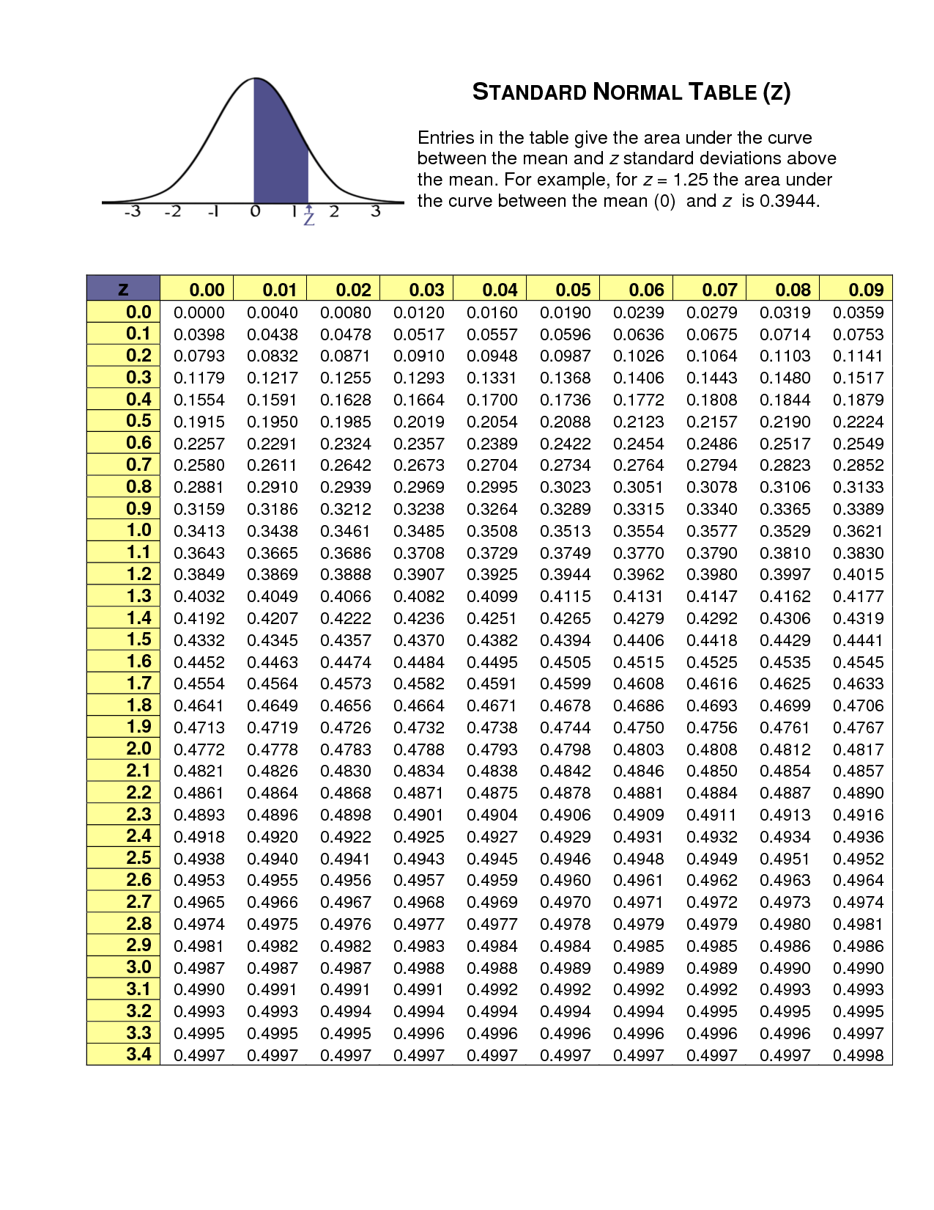
Standard Normal Table
symmetric
-x
x
Standard normal distribution function

Slide 12
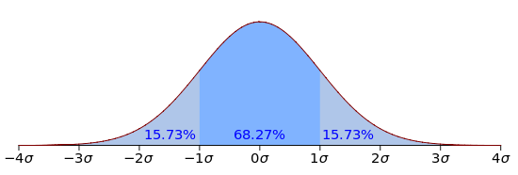
Standard Deviations
68.27% of the time X will be within 1 standard deviation of the mean

Slide 13
Binomial Approximation
Easier to compute e.g. “probability of getting <60 heads from 100 flips of a coin”

Slide 14
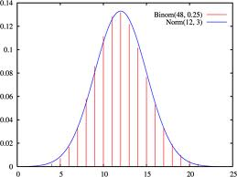
Normal Approximation to Binomial

Slide 15
<60 Heads from 100 Flips
p=0.5!

